Slide 1
ENVIRONMENTAL HEALTH

Slide 2

SOCO FORT PORTAL :
Environmental Health
Mr. Mugisa Tony (DCM&CH, BSC PH, MPH)

Slide 3
2
Introduction to environmental health

Slide 4
Course description
3
Definition of environmental health
Sources of water
Sources of water contamination
Two common ways of protecting water ( protected spring, protected well)
Methods of treating
Water related, water borne, and water washed diseases
Criteria for good housing common wastes in the community
Methods of refuse disposal
Personal hygiene
Occupational hazards and occupational accidents

Slide 5
11
Introduction
In the developed countries the concept of environmental health promotion is high on the development agenda while the developing countries, it is a relatively new topic.
Most people, including those in authority think of it as a problem of tomorrow that they do not need to worry about now.
In this lesson we will examine biological, physical and
chemical factors that link health to the environment.
Also, we will define some of the key operational concepts related to environmental health and sanitation.

in

Slide 6
12
Linking human health to the environment
Human
 Human health and survival depend on the health and
integrity of the whole environment.
 Human activity is often oblivious of the implications to
the environment and man forgets that his/her well-being depends on the health and integrity of the whole environment in which he/she lives.
 Man is also oblivious of the effect of their actions on other plant and animal species.

Slide 7
13
Linking human health to the environment
Human
 It is now universally accepted that degenerative
diseases are due to toxic pollutants and environmental
contaminants; besides personal habits and lifestyles; e.g. smoking, drinking, high fat diets, and lack of regular exercise.
 Improvement in environmental and living conditions, provision of social services and erection of barriers to diseases can significantly promote public health and subsequently the quality of life.

Slide 8
Linking human health to the environment
Improvement in environmental conditions and erecting barriers to diseases include:
a)
b)
c)
d)
e)
f)
g)
h)
Suitable sleeping and working conditions
Enough and wholesome water supply
Proper handling and disposal of human wastes
Avoidance of overcrowding and stressful conditions
Control of environmental pollution and degradation
Elimination and control of disease vectors
Improvement in food supply and nutrition
Adopting of a healthier personal life styles etc. etc.

Slide 9
Linking human health to the environment
15
 Society cannot avoid acknowledging and meeting the challenges
of environmental health promotion.
 Indifference to investing in environmental health interventions now
will result in paying in other ways such as:
 high medical bills
 cost of treating water supplies
 damage to crops and forests
 buildings and the loss of aesthetic beauty in the country side
 time wasted because of illness
 premature deaths
 un necessary human suffering, e.t.c

Slide 10
Linking human health to the environment
15
 Society cannot avoid acknowledging and meeting the challenges
of environmental health promotion.
 Indifference to investing in environmental health interventions now
will result in paying in other ways such as:
 high medical bills
 cost of treating water supplies
 damage to crops and forests
 buildings and the loss of aesthetic beauty in the country side
 time wasted because of illness
 premature deaths
 un necessary human suffering, e.t.c

Slide 11
17
Operational Concepts
Environment
“Conditions, circumstances that influences the surround and affect the development of an organism or groups of organisms” (Environmentalists).
“Man and the community in which, he/she lives”, including his/her relationship with air, water, land and all other living things (Webster International Dictionary).

Slide 12
Operational Concepts
18
Environmental Health
“A process concerned with the
control of all those factors in man’s environment,
which exercise or may exercise a deleterious
(harmful) effect on his/her physical, social, emotional
development, health and survival”.
Environmental health, therefore, is an applied science, where consideration is given to the physical, chemical, biological, social, economic and political environments to promote public health.
promotion and

Slide 13
Environmental health;
comprises those aspects of human health, including quality of life that are determined by physical, biological social and psychological factors in environment.
It also refers to the theory and practice of assessing, correcting, controlling and preventing those factors in environment that can adversely affect the health of the present and future generations (WHO 1993).
Environmental health also may refer to prevention of diseases and promotion of health by eliminating or controlling the environmental factors which form links in the chain of disease transmission.

Slide 14
19
Operational Concepts
 Public Health
 “The science and art of preventing
diseases, prolonging
life, and promoting health and efficiency through
organised community efforts for the sanitation of the environment, the control of communicable diseases, and the education of the individual in principles of personal and public hygiene”.
 These efforts relate to health service delivery, which involve health behaviour, motivation, preservation and research.

Slide 15
Operational Concepts
20
 Environmental Sanitation
“A process where people demand,
sustain hygiene and a healthy environment by
erecting barriers to prevent the transmission of diseases” (UNICEF,
1997).
These efforts relate to health service delivery, which involve health behaviour, motivation, preservation and research.
develop and

Slide 16
Disease
Trouble or a condition of the living animal or plant body or one of its parts that impairs the performance of a vital function
Safe: Free from harm or risk Secure from threat of danger, harm, or loss Zero risk
Risk: Possibility of loss or injury, peril

Slide 17
Environmental Health Sciences: The study of those factors in the environment that affect human health”

Slide 18
Facets of Environmental Health
Environmental epidemiology: Associations between exposure to environmental agents and subsequent development of disease
Environmental toxicology: Causal mechanisms between exposure and subsequent development of disease
Environmental engineering: Factors that govern and reduce exposure
Preventive medicine: Factors that govern and reduce disease development
Law Development of appropriate legislation to protect public health

Slide 19
Environmental sanitation
Improve access to safe and sufficient water supply, to encourage sanitary disposal of human excreta & household wastes, and to change human behaviour through hygiene education.
The purpose of these interventions is to prevent transmission of diseases arising from poor environmental sanitation.

Slide 20
Environmental sanitation:
is a subset of Environmental Health, it may also be defined as safe management of human excreta and associated personal hygiene;
the safe collection, storage and use of drinking water; solid waste management; drainage and protection against vermin and other diseases

Slide 21
Sanitation:
Sanitation is a Latin word ‘SANITAS’ meaning health; quite often sanitation is limited to the availability or absence of latrine.
Latrine coverage has been used as the main indicator for good or poor sanitation however sanitation can be looked at in broader terms as to encompass;
The promotion of skills and practices that enable individuals and communities to:

Slide 22
WATER
Learning objectives:
Explain the hydrologic cycle
Explain causes of underground water contamination.
List reasons why water is essential to health
Explain the water related diseases
explain water treatment process
Explain the different sources of water
Describe various sources of water contamination
Describe how water sources are protected
explain rain water roof catchment systems
explain methods of community water supply

Slide 23
Introduction
Water exists in form of gas, liquid or solid.
Without water there would be no life on earth.
“Water is life” and forms two thirds of human body.
It is essential for keeping human beings clean and healthy.
However if poorly handled it becomes a media for water borne diseases

Slide 24
Reasons why water is essential to Health
Water is essential for life and health, but it can also be a source of danger especially if it is contaminated and not treated.
It is part of every cell in our bodies and is necessary for most basic functions like respiration and digestion.
It is a good solvent and many substances, some useful and some harmful to life may be dissolved in it.

Slide 25
Reasons why water is essential to Health
It is necessary for basic body functions like digestion, It is necessary for personal hygiene and It is also used in washing utensils and clothing
It is used in cooking food
It is essential for animals and plants

Slide 26
The hydrological cycle:
The Hydrologic cycle involves the continuous circulation of water in the earth-atmosphere system.
Of the many processes involved in the hydrologic cycle, the most important are:
evaporation,
transpiration,
condensation,
precipitation, and
run off

Slide 27
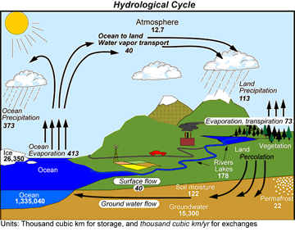
Hydrological cycle

Slide 28
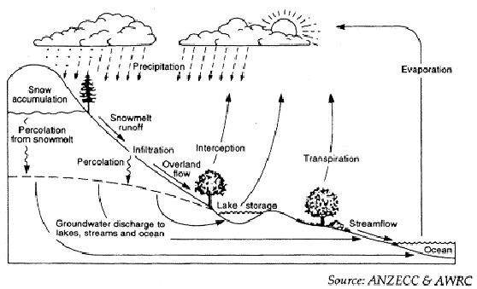
The hydrological cycle.

Slide 29
Hydrological cycle ………..
Land moisture is in constant motion.
Together with moisture from water surface participate in the cyclic motion called the hydrologic cycle.
The term cycle implies that water comes from a single source and ultimately returns to that source.
Water that participates in the hydrologic cycle exists in greatest amounts in oceans which are primary sources.

Slide 30
Occurrence of ground water and movement:
When precipitation falls to earth as snow, water or hail, vegetation and buildings intercept some part of it.
This water doesn’t reach the ground during low intensity storms.
It is re evaporated.
During heavy precipitation, water reaches the ground and follows several pathways:

Slide 31
Occurrence of ground water and movement: ……..
Some of the precipitation evaporates from the soil surface and returns to the atmosphere almost immediately.
If precipitation exceeds the infiltration and evaporation rates, water will collect on the surface. (Depression storage).
If water continues, water in low lying areas will begin to run together, this is over land flow.

Slide 32
Occurrence of ground water and movt:.
The over land flow that enters streams is called surface run offs.
Water that enters the ground may temporarily remain in the soil zone.
It may flow laterally above the ground water table until it reaches a stream or other low lying water body or may continue to infiltrate down ward until it reaches the water table.

Slide 33
Occurrence of ground water and movt:.
Water that remains in the soil zone may be used by plants or evaporates directly. Ground water is the water that enters freely into wells.
Ground water contamination: Contamination is the degradation of natural water quality as result of mans activities.
The degree of permissible contamination depends on intended end use, or uses of water.

Slide 34
Sources of water contamination
Industrial waste
human excreta,
Grave yards,
Agricultural in puts (pesticides, acaricides)

Slide 35
Common sources of water for community consumption;
Different communities use different types of water, depending on the availability,
accessibility,
affordability and
acceptability.
These include;
Public tap-stands (piped water),
Bore holes,

Slide 36
Common sources of water
springs (protected and unprotected),
shallow wells (protected and unprotected),
ponds,
streams,
rivers,
lakes,
swamps,
rain,
water holes.

Slide 37
Activity
Explain the following terms as applied to the Hydrological cycle?
Evaporation
Transpiration
Precipitation
condensation
Run off

Slide 38
Water sources …….
The sources of water include: Lakes, rivers, ponds, boreholes, wells, springs, rain;
these can be divided into three main groups;
Rain water
Surface water: which also includes water that falls on high hills (upland surface water).
Underground water;

Slide 39
Rain water;
Advantages:
Rain water has advantages in a sense that, if collected from iron sheets or tile roofs with gutters into clean closed tanks, this is normally the purest natural water.
Disadvantages;
It is very difficult to collect from grass thatched roofs.
Gutters and large tanks are required to store sufficient rainwater to last into the dry season.
The water is ‘soft’ and does not contain any essential mineral salts and

Slide 40
Surface water
When rain falls it collects on the surface in streams, rivers, ponds, lakes, swamps and dams, some of it gradually soaks down into the ground until it meets a layer of very hard earth or rock, which it cannot get through.
Such a layer which may be near the surface or deep down is called an impermeable layer.
If the water emerges by itself the source is called a spring.

Slide 41
Surface water….
If you have to dig to reach the water, it is called a well.
With a machine, a hole may be bored through the impermeable layer using machines to form a bore hole.

Slide 42
Advantages
The ponds, lakes, shallow wells, springs, streams, shallow springs, rivers, water holes or dams, are the commonest source of water for most people.
Water is easily accessible, can be obtained by hand or by simple pumps and
the larger lakes and rivers are permanent all the year around.

Slide 43
Disadvantages
Surface water is easily and frequently polluted as it runs over the ground where humans and animals urinate and defecate.
People also wash and bathe in it or can be polluted by chemicals used in agriculture or industry.
Attempts must be made to prevent pollution and also to purify this water.

Slide 44
Upland water;
Advantages,
The water that collects into streams above where people live is often plentiful and clean and makes very good drinking water.
If it can be piped to people living lower down the hills, the water comes by gravity and no pumping is required.

Slide 45
Disadvantages
The source must be protected.
If animal grazing or human settlement occurs in the catchments area, the water will be polluted.
In some areas the increasing population has led to shortage of land on the lower slopes of hills and people have moved up into the catchments area polluting the supply to those living below them.

Slide 46
Underground water;
Advantages:
as the water soaks through the ground and travels underground it is filtered.
Soil is a good filter.
Underground water is usually clean and often plentiful and permanent.
It may come from a long way and is not so dependent on local rain.
Many rural areas and small towns use this type of water from a bore hole

Slide 47
Disadvantages
Water from deep wells usually has dissolved a lot of salts and other minerals, making the water salty.
Sometimes it is too salty or ‘hard’ unless the salts are removed which is an expensive process.
This water generally needs pumping from great depths, often to tanks or reservoirs before reaching the user.

Slide 48
Sea water;
By the time water reaches the sea it always contains some salts.
These become further concentrated by evaporation and over millions of years sea water has become too salty for drinking.
This makes it very expensive to purify.

Slide 49
Sources of water contamination;
It is easier to prevent water from getting dirty than it is to clean it.
It is important therefore, to consider the possible sources of contamination between the time waterfall as rain and the time it is used.
Rainwater is usually contaminated when it is falling.
Rain absorbs dust, smoke and particles from the atmosphere especially in countries with big manufacturing industries.

Slide 50
Sources of water contamination
Later rainwater is contaminated during collection when the collection surfaces are dirty.
That is containing rotten leaves, dust, smoke, insects, or birds’ droppings and these usually collect into the storage tank.
Human and animal faeces, refuse, may contaminate river water and industrial wastes.

Slide 51
Sources of water contamination
Shallow wells may be contaminated by contents from nearby latrines, excreta washed into it from surrounding ground, nearby latrines or by dirty containers used for drawing water.
When water runs over the earth, it may become contaminated with human or animal wastes, refuse, fertilizers or industrial wastes.
This contamination is less high up on the mountain and greater near towns.
Bathing may contaminate rivers, lakes and dams and also by urinating or defecating in the water.

Slide 52
Sources of water contamination
Piped water may be contaminated from leaks in the pipes especially when these pass near foul water or dirty drains.
Water may be contaminated during storage or service at home, if the containers used are not clean.

Slide 53
Sources of water contamination
Note: Contamination of water is mainly from human and animal wastes.
These contain disease-causing organisms.
To prevent this, we must protect our sources and later on treat the water before using it.

Slide 54
Safe water:
This is water that is free from disease causing organisms, toxic chemicals, colours, and smell and unpleasant taste.
Safe water chain; This is a process which aims at ensuring that water is kept safe at all stages right from collection from the source, during transportation to homes, storage at home and later use it for various purposes.

Slide 55
Uses of water
Water has various uses at household level:
drinking to sustain life, (It is recommended that a person should drink at least 2 litres of water per day)
preparing and cooking foods.
It helps to keep cool when we are hot and warm when we are cold.
bathing,
washing utensils,
clothing, and
Waste disposal through water borne systems.

Slide 56
Water vessels for Collection and transportation:
The Jerrican is the most commonly used vessel,
Sauce pans,
Earthenware pots,
Buckets,
Basins,
Pails,
Kettles, Cups, Jugs,
Drums,
Water tankers.

Slide 57
Water storage and use:
The most common storage utensils in rural communities in developing countries are the
earthenware pots (most common because of the cooling efficiency),
Tank,
Drums,
Jerrycans and
Sauce pans.

Slide 58
Common ways of water contamination;
Contamination at source
at the source is common especially where the source is un safe naturally e.g. rivers, lakes, ponds or
may be due to faulty protection of the source,
Dirty containers also play some role,
poor or un hygienic handling e.g. funneling water into containers with dirty hands,
The dirty surrounding due to human or animal activities

Slide 59
Contamination during transportation:
Dirty containers,
poor hygienic habits,
pollution by dust for open containers

Slide 60
Contamination during storage;
Poor handling like scooping for drinking,
dirty containers,
poor maintenance of the water storage and usage containers,
poor hygiene habits.

Slide 61
Diseases transmitted by water and
Although water is essential for life and health, it can also be a danger to health.
Diseases transmitted through water, can be divided into four main categories:
Water-washed diseases
Water-borne diseases
Water-related diseases
Water-based diseases

Slide 62
Water- washed diseases;
In situations when there is limited water supply, the standard of personal hygiene drops.
When this happens, there is possibility of disease transmission and spread.
Examples of water washed diseases are:
diarrhoea,
skin diseases including scabies,
eye diseases including trachoma,
louse borne fever.

Slide 63
Transmission of water washed diseases
The diseases are transmitted by:
1) faecal-oral route due to lack of washing hands, eating utensils and vegetables.
2) Lack of personal hygiene i.e. washing face, eyes and body.

Slide 64
Prevention strategies
Water-washed diseases are preventable by improving
Quantity of water,
water accessibility and
reliability of domestic water supply and hygiene.

Slide 65
Water- borne diseases;
When water carrying or hiding pathogenic organisms is drunk, the organisms cause diseases which are referred to as water-borne diseases.
Examples are: Typhoid, Cholera,
poliomyelitis,
amoebiasis and
hepatitis A.

Slide 66
Water- borne diseases transmission
These are mainly transmitted by faecal-oral route.
Water- borne diseases prevention:
Prevention is by:
improving the quality of drinking water
use of water from protected sources.
Treatment of drinking water

Slide 67
Water-related diseases (by insect vectors)
The breeding of vectors in water can also cause specific diseases.
These diseases are in some way are related to water since water is necessary to play a role in the life cycle of a disease vector.
Examples are:
malaria,
Trypanosomiasis (sleeping sickness),
Onchocerciasis (river blindness) Yellow fever

Slide 68
Prevention of water related diseases
Improve surface water management,
destroy breeding sites of insects,
decrease the need to visit breeding sites and
use mosquito nets in case of mosquitoes.

Slide 69
Water-based diseases
A water-based disease is one whose pathogen spends part of its life cycle in water e.g. snail or other aquatic animal.
All these diseases are due to infections by parasitic diseases which depend on aquatic intermediate hosts to complete their life cycles.
Examples of water-based diseases are: schistosomiasis (bilharzias), dracunculus medinensis (guinea worm);

Slide 70
Prevention of water based diseaeses:
Decrease the need for contact with infected water,
Control snail populations,
reduces contamination of surface waters

Slide 71
Diseases transmitted by water
Water-washed diseases | Diarrhoea and dysentery Skin diseases including scabies Eye diseases including trachoma Louse borne fever | Increase on quantity of water at community level Accessibility & reliability of domestic water supply is important. Improved Hygiene

Slide 72
Prevention of water based diseases:
Water-borne diseases | Typhoid Cholera Poliomyelitis amoebas Hepatitis A | Improve the quality of drinking water. Prevent casual use of unprotected sources of water.

Slide 73
Prevention of water based diseases:
Water-related diseases | Malaria Trypanosomiasis (sleeping sickness) Onchocerciasis (river blindness) Yellow fever | Improve surface water management. Destroy breeding sites of insects. Decrease need to visit breeding sites. Use mosquito nets.

Slide 74
Prevention of water based diseases:
Water-based diseases | Schistosomiasis (bilharzias) Dracunculus medinensis (guinea worm) | Decrease need for contact with infected water Control snail populations Reduce contamination of surface waters

Slide 75
METHODS OF TREATING WATER (WATER PURIFICATION).
Objectives of the unit:
Explain the different methods of water purification at house hold level
Describe systematically the steps involved in a water treatment plant at municipal level
Differentiate simple water filtration techniques at home from filtration in the municipal water treatment plant

Slide 76
Methods of water purification
There is no simple and reliable water treatment process suitable for small community water supplies.
It is better to choose a source of naturally pure water and then collect or protect it from pollution so that treatment is not necessary.
Preventing water from getting dirty is easier than cleaning it afterwards.
However there are many occasions when relatively dirty water has to be used.

Slide 77
So it is important to know the ways of cleaning it.
Sometimes even when we protect our water sources, we cannot avoid contamination.
To avoid disease from water completely, we must treat our water.

Slide 78
Water purification methods
Water can be purified in the following ways: Storage,
Sedimentation,
Filtration,
Sterilisation, and
Boiling.
Storage and Boiling are the most common methods of purifying water in rural communities.

Slide 79
Boiling
Heat kills microorganisms,
virtually all entero- pathogens are readily killed by temperatures at the boiling point of water.
The process of heating water to a boiling point makes it hot enough to disinfect it.
This works perfectly when boiling point is sustained for 15 minutes.

Slide 80
Boiling ……………..
Allow the water to cool and store in clean containers.
Wash hands,
use a clean cup to draw the water.
Serve water in jar or cup,
its much safer to use a vessel that is fitted with a lead and tap for storage.

Slide 81
Storage
When water is stored, all the particles and microorganisms present in water settle at the bottom of the container and they can be poured away.
If water is allowed to stand, many of the harmful organisms which may be in it die because they cannot survive in water for a long time.
This also allows some silt (suspended matter) to settle out.
Using three water pots can do it.
Two of the pots should be large and used for fetching water on alternate days.

Slide 82
Storage…..
The first pot should be allowed to stand for 24hrs, then it is poured in the smaller pot and the remainder is used for washing.
The 2nd big pot is then used in the same way as the first.
Some treatment can be obtained by careful design of storage tanks on a large scale or on a very large scale in reservoirs.
This should stand for 3-7 days before use.
If water is stored for at least 48hrs, any schistosome’s cercariae in it will become non-infective before they leave the tank.

Slide 83
Diagram of the three-pot system

Slide 84
Sedimentation
Sedimentation allows water impurities and foreign matter to settle down for easy removal.
This method improves on the colour of the water but does not kill the germs.
The procedure is that you allow water to stand in a container so that solid particles and impurities settle at the bottom leaving clear water on top for decanting (pour off clean water into another container).

Slide 85
Sedimentation
Sedimentation is assisted by adding chemicals called coagulants.
Aluminium sulphate. (Coagulant) When added to water, it causes small particles to come together in clusters known as flocs that settle easily.
For larger communities, a small sedimentation tank can be built although it is not usually possible to arrange for coagulant chemicals to be added to the water to assist sedimentation.

Slide 86
Sedimentation
Sedimentation does not remove some of the harmful organisms from polluted water but it helps to clarify water for treatment by filtration or chlorination.
Sedimentation works well in big horizontal flow tanks where water moves from end to the other especially in NWASC.

Slide 87
Filtration
Water is filtered to make sure that all particles and most of the micro organisms are eliminated from water.
Simple cloth filtration:
The method removes both fine and heavy suspended particles in water and improves on color but doesn’t kill the germs.
Place a clean cloth over a clean container then pour water in the container.

Slide 88
Filtration
It is an important treatment process through which bacteria are removed from water using large sand filters or small or home filters.
It can be done on a small scale for a household or on a large scale for a village or town.
The best simple household filter is a candle filter but it is expensive.
The filter is made of pottery in the shape of a big candle.
It also has two containers.

Slide 89
Candle filtration
Made up of hollow cylinders one end is closed and the open end is fitted with a watertight joint to a metal which carries a metal nozzle communicating with the interior of the filter.
The filter is mounted in a container like an open cylinder one end is completely closed by the filter screwed into cylinder in the upright position, with the filters projecting into the cylinder.

Slide 90
Candle filtration
Water is poured a round the candles. Water makes its way (filters) through into the interior of the candles and comes out through the nozzle.
Water comes out free of bacteria because bacteria will have been entangled in the candle pores.
The process is mechanical, bacteria is not killed therefore filters should always be sterilized.

Slide 91
Candle filtration ………………
The organisms vary tremendously in size, from large parasitic cysts (Giardia and Entamoeba histolytica to smaller bacteria (E. coli, Campylobacter to the smallest viruses.
Thus, the effectiveness of the filters work depends to a great extent on the physical size of the pores in the filter medium

Slide 92
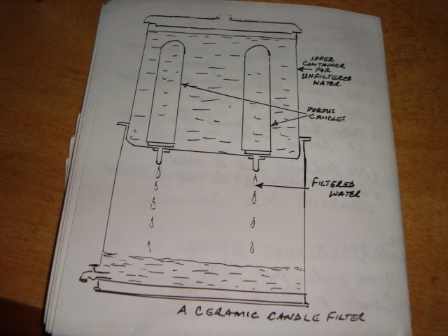
The diagram of a candle filter

Slide 93
Candle filtration……..
Water is put into the top container, filters through the pottery candle and is stored in the bottom container.
The candle is the most commonly used home filter.
From time to time the candle is brushed as water goes through and it cleans it.
Some candles have a silver catalyst that kills bacteria.

Slide 94
Advantage of filtering
Providing immediate access to drinking water without adding an unpleasant taste.
Disadvantages:
micro cracks within the filter may allow passage of unfiltered water,
they can become contaminated;
no filters are fine enough to remove virus particles (Hepatitis A, rotavirus virus, and poliovirus).
In addition, they are expensive and bulky compared to iodine

Slide 95
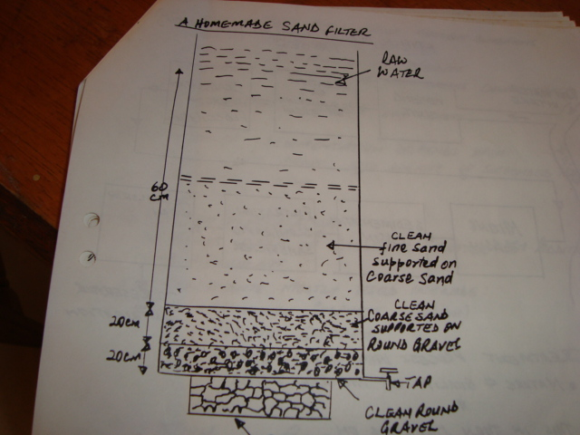
Diagram of homemade sand filter

Slide 96
Sand filter
The commonest large-scale filter is made of different grades of sand.
It is arranged in layers with stones at the bottom, then coarse sand (large grains), and fine sand (small grains) on the top.
Sand filter for the public water supply are usually built in concrete containers
for a few houses, smaller sand filters in special metal containers may be useful.

Slide 97
Sterilisation
It is the final stage of water purification necessary for wholesome drinking water.
The idea of sterilising water is to make it completely free from micro organisms.
Micro organisms will die when you sterilise water.
On a large scale for big towns, this is done in the water works by adding chlorine to water that has been filtered.
On a small scale, water may be sterilised either by boiling or by adding disinfectants such as chlorine or iodine.

Slide 98
Boiling
It is capable of destroying most micro organisms, ova and cysts.
It is the easiest and safest way to sterilise water, but very few people are prepared to do this regularly.
The water must reach boiling point and boil for 15-20 minutes.
Boiling cannot destroy toxic chemicals. No technical skill is used.
Boiled water should be safely stored.

Slide 99
Chemical treatment;
Chemical disinfections of water depend on the killing of bacteria, Guardia and amoeba cysts, and viruses by the chemical.
Halogens (chlorine and iodine) are most commonly used.
The important points are that the killing effectiveness of the chemical is dependent on concentration of the chemical, and contact time

Slide 100
Chlorination;
Usually in liquid form (Klorin) or powder form (PUR-Purifier of water) or tablet form.
For application of the liquid form; shake the bottle before use.
For 20 litres of water add 1-2 bottle cups full of liquid chlorine.
Stir and shake water well for 30 seconds and cover it immediately.
Use the water after one-hour treatment, for powdered form, add one-sachet to10 litres of water and stir well.
Allow water to rest for five minutes.
Use 100% cotton cloth without any holes to filter the water.
Allow water to rest for 20 minutes before drinking.

Slide 101
Iodine;
It can be obtained as 2% tincture of iodine,
two drops are sufficient to disinfect one litre of water
iodine tablets such as globaline and portable aqua (commercial names) are also used in the sterilisation of small amounts of water
Use as directed by the manufacturer.

Slide 102
Bottled Water;
Bottled water is relatively safe if well handled,
however they are recorded instances of contaminated bottled water contributing to cholera epidemics.
Some bottles of various brands of water were cultured and a significant percentage grew enteric pathogens (diarrhoea-causing organisms).
Carbonated water is acidic enough (due to the dissolved carbon dioxide) to kill contaminating bacteria.

Slide 103
Disadvantage of bottled water
Expensive,
not always available.
Plastic bottles form unnecessary waste disposal problem

Slide 104
Herbal Treatment Of Water.
Moringa oleifera
It’s a plant is used to purify dirty water.
The moringa seeds are used as coagulants to temporarily precipitate suspended solids and bacteria from dirty water.
One litre of water in a Jar is mixed with a tablespoon of powdered moringa seeds and stir.

Slide 105
Moringa olifera ………….
Allow it to stand the suspended solids precipitates with 98% of the coliform bacteria are removed from the water.
Presence of coliforms in water is an indication of faecal contamination of water.
Decant treated water into a clean jar or cup because moringa seeds start smelling and fermenting after 12 hours.
Moringa has no side effects neither is it poisonous.

Slide 106
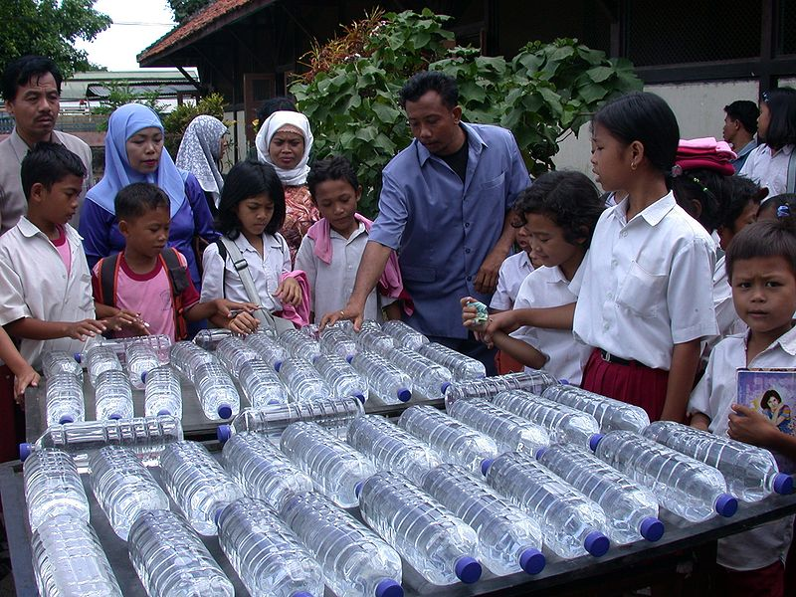
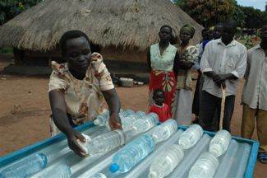
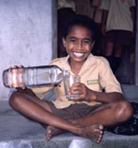
Solar Disinfection (Sodis)
This method depends on Solar (sunlight energy).
Ultra-violet rays from the sun are used to inactivate pathogens present in water.
Most ideal method for treating smaller quantities of water at house hold level for drinking.
This technique involves exposing water in clear transparent plastic bottles to sunlight for a day, for example on the roof of a house.
Bottles need to be cleaned, filled to three quarters and shaken thoroughly 20 times, before being filled and completely aerated (oxygen).

Slide 107
Sodis ………….
To absorb more heat and raise the water temperature, the container is painted black on one side and placed on black surface with clear side facing the sun.
The bottles are then exposed to sunlight for 6 hours (or for 2 days if the sun is obscured by clouds).
The water should be consumed directly from the bottle or transferred in a clean glass for drinking.
The treatment process; ultra violet rays from the sun kills the disease causing organisms.
The infra red component will heat the water to enhance the killing rate of organisms.

Slide 108
Solar Water Disinfection at Household Level

Slide 109
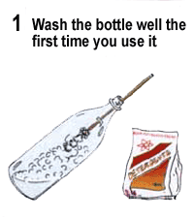
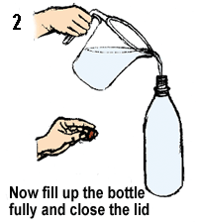
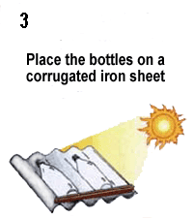
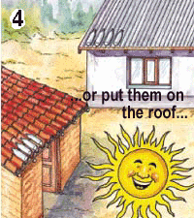
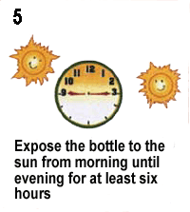
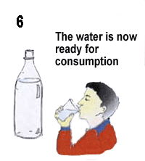
HOW TO USE SODIS

Slide 110
Municipal Water Treatment Process
Raw water
Pumping unit
Aeration – pre-chlorination unit
Coagulation/flocculation unit
Mixing basin
Sedimentation basin
Filtration/slow/rapid sand filter
Post chlorination unit
To reservoir

Slide 111
Aeration
This assists in the removal of odour and tastes. It removes substances like:
Dissolved iron and manganese, which impart brownish colour to water.
Dissolved gases like carbon dioxide
Odours due to decomposed organic matter

Slide 112
Pre-chlorination
It accomplishes similar objectives to aeration
It also controls the growth of algae
Coagulation/flocculation
It takes care of colloidal matter by addition of a coagulant
The coagulant mostly used include:
Aluminium sulphate, ferrous sulphate, Ferric sulphate

Slide 113
Sedimentation
This takes place under quiescent (still) conditions and it achieves the following results.
Removal or reduction of turbidity
Removal of substances that cause colour, taste and odour.
Removal of bacteria, ova and cysts
Efficiency of sedimentation depends upon:
Type, size, shape and weight of suspended matter
Retention time

Slide 114
Filtration
Filters work by physically removing infectious agents from the water.
Water is allowed to pass through a bed of filtering media like; a clean cloth, sand and gravel;
sand and gravel is very efficient in retaining colloidal particles including bacteria and viruses.
Filtration Medias are either pre-manufactured or built at community or home e.g. slow sand filter.

Slide 115
Rapid Sand Filter (RSF)
The rapid sand filter or rapid gravity filter is a type of filter used in water purification and is commonly used in municipal water treatment facilities.
Rapid sand filters use relatively coarse sand and other granular media to remove particles and impurities that have been trapped in a floc through the use of flocculation chemicals typically salts of aluminium or iron.
Water and flocs flows through the filter medium under gravity or under pumped pressure and the flocculated material is trapped in the sand matrix. Rapid sand filters must be cleaned frequently often several times a day by backwashing.

Slide 116
Backwash is the backwards flow of air or water.
Backwash can be created naturally by waves rebounding off a beach or other obstacle.
It is created by propulsion devices such as an engine.
Under gravity or under pumped pressure the flocculated material is trapped in the sand matrix.
The RSF is designed to filter a large volume of water in a very short time.
The rate of filtration of RSF is about 4.8 /m³/m²/hour (about 115m³/m²/day) or about 80 litres/m²/min.

Slide 117
The principle of operation of RSF is basically physical straining of the water
It requires very small space compared with a slow sand filter
Good for urban areas
Before water is released into the RSF, it is first treated with coagulants followed by sedimentation
Rate of filtration is 30-40 times higher than that of a Slow Sand filter
Therefore, a RSF will need cleaning more frequently than SSF and because of this frequent cleaning it is designed with a back wash system for cleaning purposes.
A well designed and a well-operated sand filter will remove from 97% to 99% of bacteria in the raw water.

Slide 118
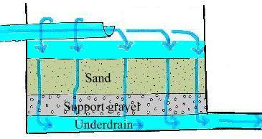
Diagram of a Rapid Sand Filter

Slide 119
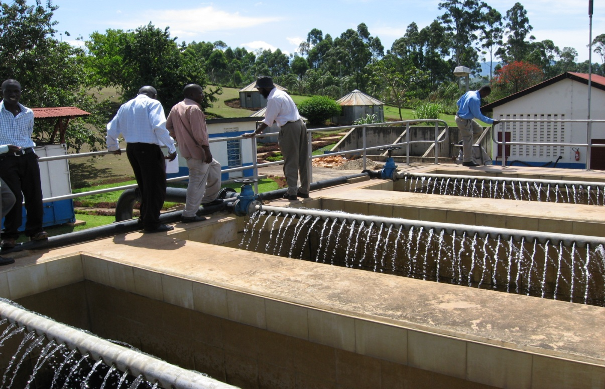
NWSC Fort portal

Slide 120
Slow Sand Filter
The process of filtration is a combination of sedimentation, physical straining and biological activities.
Rate of filtration for SSF is 0.2m³/m²/ hour;
Growth of micro organisms takes place in the topmost layer of the sand grains soon after the filter is put into use.
The microbial growth forms a sticky gelatinous coat on top layer of sand.
This layer forms due to the uninterrupted operation of the filter.
Formation of this layer promotes the efficiency of the filter medium

Slide 121
Slow sand filter ……..
As time passes, this efficiency lowers the rate of filtration until it becomes unacceptably low.
When it reaches this point, the filtration is stopped, the topmost layer of the sand is scraped off, and the filter is put back into operation.
There are several advantages of slow sand filtration over other methods of water disinfestations:

Slide 122
Slow sand filter…….
It is a low energy consuming process,
It has great adaptability in components and applications maintenance is minimal.
Systems can be built and installed by laymen.
The costs of building and running SSF are significantly than lower than for other disinfection methods

Slide 123
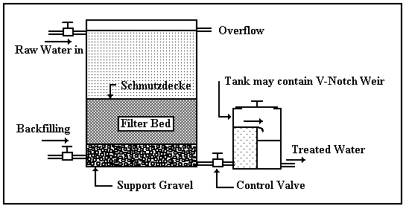
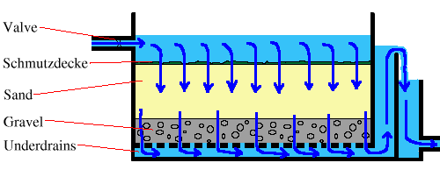
The diagram of a typical slow sand filter

Slide 124
WAYS OF PROTECTING WATER SOURCES
objectives of the Unit
Describe the steps taken in spring protection.
Explain the sources of water pollution for open and protected springs.
Explain the sources of water contamination in open wells and describes the steps taken in well protection.
Describe the water drawing mechanism using a pump.

Slide 125
PROTECTION OF SPRINGS AND GRAVITY WATER SYSTEMS
Springs have a reliable flow and can make ideal sources of water for a community water supply.
No pumping is required to extract water from them.
Springs are protected so as to increase spring water yield and reliability.
Springs are protected from surface pollution and contamination by users

Slide 126
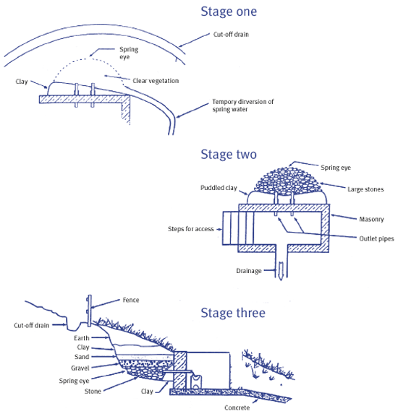
Stages of spring protection.

Slide 127
Springs
Springs are protected by building a box of brick or concrete around the spring so that water flows directly out of the box into a pipe without being exposed to pollution from outside.
An impervious layer of soil or rock i.e. a layer through which water cannot pass forces the water emerging at a spring.
In excavating the foundations for a spring box, it is important to avoid digging through this layer, or the water may seep downwards so that the spring disappears or moves downhill.

Slide 128
Steps in spring protection
1. Community approval: The community should be consulted for their consent, approval and participation.
Then an agreement with the community on the roles and contribution of each partner should be made.
2. Preliminary assessment of the spring
The following assessments should be made:
Permanency of the spring
This can be confirmed by use of retrospective information by key persons in the community, usually the aged persons.

Slide 129
Possible sources of pollution
A sanitary survey should be undertaken to find out any possible source of pollution to the spring.
These may include:
The refuse damps
Pit latrine constructed close and to the upper side of the spring
Soakage pits
Indiscriminate defecation by communities on the upper side of the spring.
Water yield; since most springs have more than one weeping eye, the spring water yield is best determined after opening the spring eyes. –
Water from the spring eyes is then directed to a common point and into a container of known volume.

Slide 130
The time taken to fill the container is measured and yield calculated by dividing the volume of the container by time taken and expressed in litres per unit time.
Spring yield is important in determination of size of spring box, which serves as a temporary reservoir and for estimating water demand from the spring
This is done by obtaining data on the number of people using the spring, and the average daily water demand for households based on water uses. –
The community should be involved in this exercise.

Slide 131
Other feasibility assessments;-
These include:
topography or ground formation around the springs,
access to the spring and
availability of materials including local materials.

Slide 132
3. Sketch planning
A neat initial sketch of the spring box, embankment wall
and other spring accessories such as:
cattle trough and
cloth washing area,
water drawing area,
diversion channels and
fencing should be done.

Slide 133
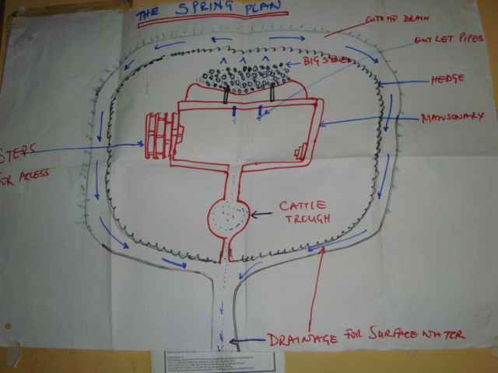
Sketch plan of a spring.

Slide 134
4. Procurement/ collection of necessary materials
An estimation of the materials required should then be done. –
As part of their contribution, the community should be able to provide locally available materials.
The other required materials should be procured and transported to the site.
The necessary tools and equipment should be assembled.

Slide 135
5. Opening the spring eyes and excavating
The spring should be done by digging around the eye of the spring to remove all mud and other wastes in order to open and expose the weeping eyes.
This often increases the spring flow.
Then assessment of spring yield should be repeated.
All eyes should be covered by the embankment wall

Slide 136
6. Construction of embankment wall and spring box
The embankment wall
This is supposed to collect water from all the spring eyes and direct it into the spring box.
The wall should be extended to collect water from all the eyes.
The embankment wall should preferably be constructed of concrete and should be leak proof to prevent water seeping through.
All the water collected should be directed to the spring box through the inlet holes at the back of the spring box.

Slide 137
The spring box
This acts as a temporary water reservoir and a settling receptacle for suspended solids in the spring water.
It also holds the draw pipes, the overflow and the wash out pipes.
The spring box should be leak proof and covered to minimise contamination.
Inlet to the spring box should be placed slightly higher than the outlet so as to avoid backpressure on the spring eyes, a situation that may result into spring diversion.
Adequate overflow should be provided slightly higher than the draw pipes.

Slide 138
7. Construction of other spring components
The water drawing area should be constructed to the convenience of the water drawers.
In designing this component, the height of the common water drawing containers should be considered.
Where the ground formation is steep, stairs should be provided to enable drawers move down and up from the spring with less strain.

Slide 139
Important points on spring protection
The point where the water emerges known, as the “eye” of the spring should be covered carefully covered with selected gravel. The material should not be too coarse to erode the soil behind it and not finer than the existing soil behind it to block the flow.
Stones are placed in gradually increasing the size towards the spring box.
A spring may sometimes flow very strongly for brief periods of rain and the whole structure must be sound enough to resist erosion.

Slide 140
Important points on spring protection
In most springs, fine sediment is suspended in the water.
A spring box therefore should be built so as to prevent this sediment from settling over the eyes of the spring and blocking its flow.
This is best done by ensuring that the overflow pipe is not above the eye.
It is also important for the spring box to have a removable cover, so that it can be cleaned from time to time.

Slide 141
Important points on spring protection
Care is required to prevent surface water from running into the spring box and polluting the water in it.
Paddled clay should be used to backfill behind the box to seal the ground against infiltration.
The top of the spring box should be at least 30cm above the ground and the access hole should have a lip around it and a cover which is not easily removed.
A ditch may be dug on the uphill side of the spring and the excavated soil thrown up into a bank to divert surface water.

Slide 142
Important points on spring protection
A fence or prickly hedge planted on the bank will help to keep people and animals away.
Make sure that the spring is not really a stream, which has gone underground and is re-emerging.
Make sure that the source and the collecting area are not likely to be polluted by surface run off.

Slide 143
Important points on spring protection
Checking that there are no latrines within 30m upstream of the spring, making sure that if the spring is to be connected to a piped water system, it is on higher ground than the area to be supplied.
Taking care that the spring tank is not built on swampy ground or on land which is subject to erosion and that the flow from the protected spring itself will not cause erosion or damage.

Slide 144
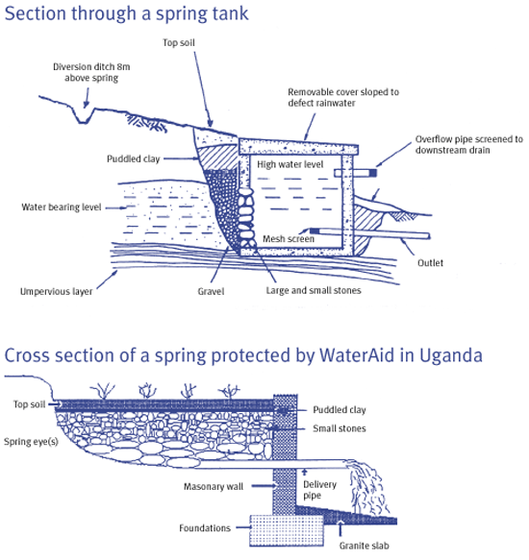
Cross-section of spring tank

Slide 145
PROTECTION OF SHALLOW WELLS
Objectives:
To discuss ways through which open wells can be contaminated.
Discuss the steps taken in well protection.
Identify the parts of a water pump and explain the mechanism by which the water pump assists in drawing water.

Slide 146
Hand dug wells are the oldest and widely used water source in most parts of the developing world.
They are dug manually with the use of simple and locally available tools.
Protecting a well may be done at a site of an existing water hole or alongside a stream or river at a point where water will filter in from below but above the level at which it may be flooded.
It is important to be as far as possible from the latrine.

Slide 147
It is best to dig a well in the dry season when there is little water.
This enables the well to be dug deeper.
It may be necessary to keep emptying the first water out to enable the digging to go on.
When the well is deep enough, the sides should be built up with stones, cement blocks or bricks.

Slide 148
Protected wells ….
The sides should be built up above the level of the surrounding ground to prevent dirt getting washed into the well.
Then the area outside the wall should be filled in to make a sloping apron.
Making the well deeper and building up its sides will greatly improve the quality of water.

Slide 149
Other improvements can be:
A water proof (preferably cement) apron should be build around the top of the well so that spilled water cannot run back into the well.
The lining of the well should be made waterproof to allow only water that has been filtered through the earth to get into the well at the bottom.
Given the limited financial and human resources, hand pumped equipped wells are the most suitable and low cost approach to providing drinking water in most rural areas.
If it is possible to obtain and maintain a pump, then a strong well cover should be made and fitted and the pump attached to it.

Slide 150
This will prevent dirty buckets being used or any other rubbish getting into the well. If appropriately lined, covered and a suitable hand operated pump installed,
the quality of the well water can be maintained with occasional chlorination of the water when necessary.
While it is better to have a cover on a well, there is no point of doing this unless arrangements for regular maintenance of the pump can be made.
If the well is covered and the pump gets broken, people will fetch water from another source with no protection creating an even worse situation than when you started.

Slide 151
Why do we protect wells?
Community shallow wells are mainly protected for the following reasons:
Prevent contamination,
avoid collapsing of the well
make the well more durable,
increase water yield,
make easier drawing of water by beneficiaries
to avoid accidents

Slide 152
Ways through which open wells may be contaminated
Open unprotected shallow wells may be contaminated through the following ways:
Polluted groundwater especially if located close to pit latrines, soakage pits or leachates from refuse damps.
Contaminated containers used in drawing water from the well.

Slide 153
Ways through which open wells may be contaminated……
Seepage from the surface through the top few metres
Rubbish thrown down to the well
Surface runoff water especially during heavy rains.
Spilt contaminated water
Cracks of the apron (if protected)

Slide 154
Ways of preventing contamination
Wells should be sited away from latrines, refuse damps and soakage pits.
The well should be located at least 30m away from the latrine.
Clean containers should be used for getting water from wells.
The container for drawing water from the well should be one and should always remain inside the well.
Where possible, hand pumps should be installed.
Wells should be properly lined to prevent collapsing of walls and contamination through upper ground seepage.

Slide 155
Children should be prevented from playing around wells.
If possible a permanent cover should be fixed to the well.
A head wall should be built to prevent surface run off.
The head wall also helps in keeping animals away from the well.
Construction of a firm apron with good spill way.

Slide 156
Ways of preventing contamination
This helps in channeling all spillage and other dirty water away from the well.
It also serves as stand for the user.
The area around the well should be kept clean and fenced to keep away animals.
A diversion channel should be dug around the well to divert storm water from the well.

Slide 157
Shallow well siting
It’s the ability to identify well points in an area.
This can be done either traditionally or by use of modern machines.
The right time to site a shallow well is during the dry period.
This allows one to get the permanent ground water when water table has stabilised.

Slide 158
Shallow well siting
The users should be consulted so as to agree on the proposed site.
This helps to avoid conflicts regarding ownership, operation and maintenance of the new wells.
The choice of site should consider risks associated with pollution, erosion, flooding and ease of access.

Slide 159
Traditional methods of well siting:
This can be done using:
Natural indicators, which include use of local vegetation such as Acacia tree,
local topography
history of other existing wells.
Other methods include:,
forked stick method,

Slide 160
Traditional methods of well siting:….
welding rods or bicycle spokes: An individual holds two bent spokes pointing in the direction of suspected water sources, as a person holding the spokes moves forward eventually the spokes will point at each other and intersect.
The point of intersection shows where the water source is.
Digging then follows on that spot until water is got.

Slide 161
Stages of shallow well development;
Digging;
this is normally done manually and lining done later.
It requires skill and experience.
The size and shape of a well depends on the quality of soil and stability.
Usually wells should have an average size of 1.5 m width for stability and minimisation of costs.
Once water is struck, the diameter can be increased so as to the increase water volume.

Slide 162
Well shape
It can be:
square
round
however, round wells:
use fewer materials,
are much quicker to build,
are suited to resist compression forces in earth quake prone areas
require less skill in construction.

Slide 163
The digging process
Digging should usually start at the end of rains.
Start with a smaller hole, which is then widened once water is struck.
Digging is done using sledgehammers, shovels, bucket and rope to remove soil. –
When water is struck, de watering is done manually or by use of a petrol (centrifugal) pump.
During construction, the water level should be kept below the level of fresh concrete and mortar.

Slide 164
Well lining
A variety of materials can be used for well lining including concrete rings, big blocks and burned brick.
Concrete rings have limited internal diameter and don’t allow one to deepen or widen the well.
Rocks are good but require a great deal of cement in construction.
Burned bricks are popular, consume less cement and are easy to construct with.

Slide 165
Well lining ……
Lining is built on top of the hard rock on a concrete foundation.
The lining is also extended to at least 1.3m above ground level for apron construction.
Strong poles are placed across the wells as building continues above them and used for standing on.
When later removed, the holes are filled with concrete; the inside of the well is plastered to a depth of at least 3m below ground level.

Slide 166
Well lining ……
Apron construction; An apron is used as a stand by the users.
It prevents floodwater from damaging or entering the well.
An apron of 1.2m wide outside the well lining is built using brick work
A spillway should be constructed to direct spillage may be to a soakage pit.

Slide 167
Casting cover slab
The cover slab should be pre-casted and later placed on the well, the slab is normally casted in two pieces for easy removal.
It should be reinforced to avoid breakages
One half of the slab is removable while the piece holding the pump is fixed.
Well fencing; The well and the area around it should be fenced to keep animals away and also maintain the surrounding area clean.
Usually local trees should be used in fencing the well.

Slide 168
Pump installation;
after the well is complete, a pump is installed for easy drawing of water and to avoid water contamination through the use of a dirty container/rope.
The well is then disinfected by use of appropriate disinfectant such as chlorine and then fenced.

Slide 169
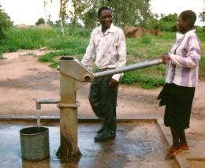
Protected well

Slide 170
Factors to consider while choosing a hand pump
Is it easy to install by the community,
easy to maintain,
easy to be repaired by women,
cheap in price,
locally available spares and
accepted by beneficiaries.

Slide 171
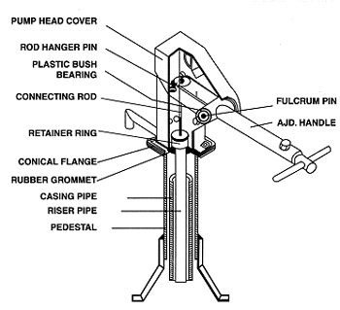
Assembly hand pump

Slide 172
BORE HOLE
It is an underground source of water, which is connected to the surface by a long pipe that is sunk by skilled technicians.
It is the most common source of safe water in Uganda.
The protection of the borehole is the responsibility of the government working hand in hand with community leaders.
Steps to protect a bore hole
Clear the bush/ vegetation around the borehole to prevent stagnation of water. Fence the borehole to prevent animals from grazing and children from playing around it. A concrete slab is built around the hand pump and a waste drain also dug. The advantage of a bore hole is that, it is a stable water sources which is also free from contamination.
Limitations in use of water from deep wells (bore hole);
Presence of metals in water like iron and manganese, these metals cause discouralation to laundry, form deposits in pipes

Slide 173
Steps to protect a bore hole
Clear the bush/ vegetation around the borehole to prevent stagnation of water.
Fence the borehole to prevent animals from grazing and children from playing around it.
A concrete slab is built around the hand pump and a waste drain also dug.
The advantage of a bore hole is that, it is a stable water sources which is also free from contamination.

Slide 174
Limitations in use of water from deep wells (bore hole);
Presence of metals in water like iron and manganese,
these metals cause discouralation to laundry, form deposits in pipes

Slide 175
RAIN WATER ROOF CATCHMENT
Objectives:
Discuss the advantages and disadvantages of rainwater roof catchment.
Describe the components of a rainwater roof catchment system.
Explain the design and construction of a Ferro cement tank.

Slide 176
INTRODUCTION
Rainwater roof catchment systems collect rain water for individual family or institutional use.
The system comprise of a collection surface, gutters, down pipes and a storage tank.
The advantages and disadvantages of rainwater roof catchment systems are many including:

Slide 177
Advantages
High water quality if well maintained.
The system is independent and hence suitable for scattered communities.
Local materials and skills can be used in rain water system construction.
No energy costs are needed to run the system.
Ease of maintenance by owner.
Convenience and easy access to water thus saving valuable time.

Slide 178
Disadvantages:
High initial capital cost may prevent a family or institution from constructing the system.
Water availability is limited by rainfall and roof area.
Mineral free water has a flat taste and some people may prefer the taste of mineral rich water.

Slide 179
THE SYSTEM COMPONENTs
a) The water catchment surface
Can be roof, rock or any other suitable surface.
Should have sufficient surface area.
Should be adequately sloped to allow run-off.
Roofs can be that of G.C.I, clay tiles or thatch.
Corrugated metal is light, easy to install and require little maintenance.
Clay tiles provide good surfaces and are long lasting than sheet metal.
Water from thatched roofs contain organic matter, is yellowish in colour and smells.

Slide 180
(b) The gutters and down pipes
Good gutters should be:
Light in weight, water resistant and easy to join together
Large enough to channel water without over flowing.
Minimum recommended depth is 7.0 cm for any gutter.
Slope should be uniform to prevent pooling of water (1 cm/m)
Gutters should be supported every 60cm.
Bamboo wood and sheet metal gutters have been used.

Slide 181
(c) The Storage tank
It is the most expensive of all the components and most difficult to construct.
It must be durable enough and plastic tanks are long lasting.
The design should be appropriate to local community
Water tank should be water tight.
Advisable to have maximum height of 2m to prevent high water pressures.
Should be covered to keep off sunshine, dirt and insects.

Slide 182
Should have a Manhole for tank cleaning and repair and also need to have screened over flow.
Must have means of removing water for use and after cleaning
A tank must have means of aeration.
Various types of rain water storage tanks are often constructed.

Slide 183
Sheet metal tanks
Have been used for many years in many parts of the world.
Their initial installation cost is quite high for most families.
Most tanks do not last more than 5 years especially in damp climate.
Ferro cement water tanks
Are named because principle construction materials are iron and ordinary cement.
With good workmanship, these tanks are quite strong and durable.
They have been tried in many parts of the world with much success.

Slide 184
Concrete tanks
Are constructed of cement, concrete and usually reinforced with iron bars.
Are quite durable and reliable.

Slide 185
DESIGN AND CONSTRUCTION OF FERRO CEMENT WATER TANKS
1. Steps:
Determine water demand
Water demand is depended on:
Water use in the family for example for drinking, cooking, cleaning, washing and watering cattle.
In most rural areas of Africa, water demand range from 15-30 litres with mean of 20 litres per person per day.
In urban centres the figure is about 50L and above.
Demand will also be influenced by other factors such as, availability of alternative sources.

Slide 186
The tank can also be designed to accommodate household demand during the dry season.
The maximum dry period should also be determined for a period of 10 years.
Example
In a family of 8 persons, the daily water use is estimated at 20 litres per person per day, the longest dry period in the area is from May to August which adds to120 days.
The daily water demand therefore is 8 x 20 lts = 160 litres.
Demand for 120 days is 160 lts x 120 days = 19,200 litres.

Slide 187
(ii) Determine supply; Supply is determined by two factors namely;
Average annual rainfall in the area in mm/year, and the available water collection surface.
Example: If the family has a Gi roof with 25 m² and the area has an average annual rainfall of 1000 mm/y,Then supply is 25 m^{3,}
The runoff co efficient for Gi roofs is 0.8 and 0.7 for all other roof types, Then multiply supply by 0.8 i.e., 25 x 0.8 = 20 m³
This supply is compared with demand of 19.2 m³
The conclusion is that rainwater roof catchment is feasible and can meet demand for this family.

Slide 188
(iii) Working out tank size
The size of the tank is determined by the following factors;
Water demand per year or during dry period
Water supply per annum.
Economic ability of family.
Availability of space for tank construction

Slide 189
HYGIENE OF RAIN WATER ROOF CATCMENT SYSTEM
HYGIENE OF RAIN WATER ROOF CATCMENT SYSTEM
The water collection surface; should be permanent, non-corrosive and easy to clean;e.g
isheet metal, tiles or any other appropriate materials.
Iron sheet roof should not be painted, the roof should be easy to clean, should be cleaned of dust, leaves and insect/bird’s dropping just before the rains begin.
Ground surface should not be used due to high chances of faecal contamination. Grass thatched roofs are not good due taste from soot

Slide 190
The gutters and down pipes
Should be light water resistant and easy to clean.
Should not be painted.
Should be cleaned just before the rains
Bamboo, wood and sheet metal gutters have been used .
Down pipes should be screened to prevent entry of leaves, insect and bird’s dropping into tanks.

Slide 191
The water storage tank
It should be water tight to avoid leakage and contamination.
Should be covered to keep off sunshine, dirt, insects and bird’s dropping.
should be provided with a manhole for tank cleaning and repair
All openings should be screened to prevent mosquito breeding and insect contamination.
Means of aeration and balancing of pressures inside the tank.
Means of removing dirty water after tank cleaning, Should be cleaned whenever dirty.

Slide 192
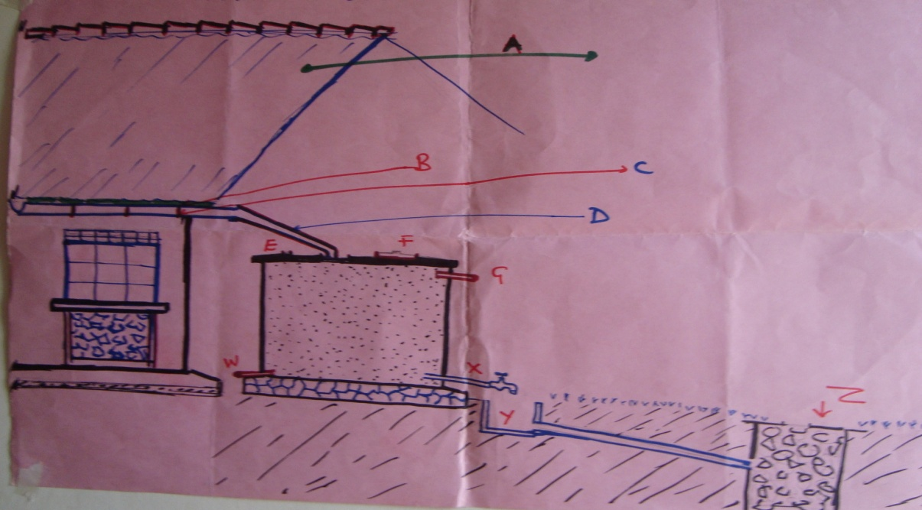
Roof catchment system

Slide 193
Criteria for good housing common wastes in the community
HOUSING
Objectives of the unit
By the end of this unit, learners should be able to:
Define housing
Describe characteristics of a good house

Slide 194
Housing:
List types of housing
Discuss importance of ventilating houses
List diseases caused by poor housing
Outline how housing affects on health
List minimum sanitary requirements for an ideal homestead
Explain overcrowding in housing

Slide 195
Introduction
The house a person lives in has an important influence upon that individual’s well being.
It also has a significant effect upon health.
The environment of the house should include all the necessary services, facilities, equipment and devices needed for the physical, mental and social well being of an individual, family or community at large

Slide 196
Housing…………………..
Definition:
Housing is a physical structure that man uses for shelter
Common types of houses
Temporary: Consists of a grass thatched roof, mud and wattle walls with poles.

Slide 197
Disadvantages of a temporary house
It can catch fire any time,
There is dampness due to lack of provision of barrier (DPC) in the wall that prevents moisture rising through the structure
Insects and vectors can enter easily and lodge in the house.

Slide 198
Semi-permanent:
It consists of an iron sheet roof and mud and wattle walls
Disadvantages:
It is less durable than a permanent one, it
Permits rising dampness into the building through the walls,
It allows in insects and vectors more easily than permanent ones.

Slide 199
Permanent:
It consists of an iron sheet roof or tiles and brick/ block walls.
Advantages:
It has a damp proof course that prevents dampness which would lead to respiratory diseases,
There is minimized leakage.
The Insects and vectors are discouraged and also
Risk of fire is lessened

Slide 200
How housing can affect health
A combination of dampness, lack of light, poor ventilation and overcrowding can contribute to the spread of air borne droplet infection.
Earth floors, walls, and unscreened windows permit the entry and breeding of flies, bed bugs and mosquitoes.
Cooking fires on the floor are hazards to small children.
it is extremely important to have improved quality of housing.

Slide 201
Qualities of a suitable house (characteristics)
Good construction:
It should be built on dry site, not subject to floods.
It should not be in a swamp or water logged area or close to stagnant water
“because such conditions may facilitate the breeding of mosquitoes and provision of latrines may be difficult”.

Slide 202
Qualities of a good house
There should be separate accommodation for humans and animals.
There should be adequate lighting and ventilation.
It should be free from dampness,
Should have separate rooms for food storage and preparation.

Slide 203
Qualities of a good house
The house should be protected against vermin and insects.
It should have a hard floor and walls preferably concrete and plaster and screened windows.
There also a great need to provide excreta disposal means e.g.
pit latrines,
have adequate method of refuse disposal e.g. burial, burning or composting.

Slide 204
Qualities of a good house
Have satisfactory water supply in quantity, quality and reliability
i.e:
Should be within easy reach,
have adequate space and facilities for bathing washing and drying clothes.
Be provided with fuel storage facilities

Slide 205
Qualities of a good house ……
Have adequate space for talking and playing.
Should have good compound and vegetable gardens.
Should not be very close to the main road in order to avoid accidents,
Dust from the road,
Storm water coming from the road, which may collect in the compound and facilitate mosquito breeding and weaken foundations of buildings.

Slide 206
Examples of bad building sites;
A site with clay soil this will not allow water to drain into the soil freely this encourages accumulation of water.
Accumulation of water will lead to mosquito breeding and water may penetrate the walls of houses leading to rheumatism due to dampness.

Slide 207
Dampness can also cause bronchitis and pneumonia.
A site on made up grounds or reclaimed lands, a site near factories for fear of problems like noise, offensive smells and dangerous wastes from factories,
A site in swampy areas.
All these mentioned sites are not ideal for good housing.

Slide 208
Misuse of houses/ rooms
Houses may be misused in several ways which include:
Cooking in bedrooms,
storing foodstuffs in bed rooms and under beds,
Sleeping in kitchens,
sharing houses/rooms with domestic animals,
keeping food utensils under beds,
charcoal in food stores,
sitting rooms and bath rooms

Slide 209
Effects of misuse of houses
Sharing houses with animals
No person should sleep in a house built for animals, the dangers of sharing houses with animals include:
Urine of animals wet floors and thus causes dampness,
Urine and droppings of animals cause obnoxious choking smells

Slide 210
The animals may transmit some zoonotic diseases to man e.g.
rabies, anthrax, TB, brucellosis, they harbour vermin like ticks, fleas, lice, flies, dog cestodes and jiggers

Slide 211
Cooking in dwelling houses
Lighting of fires in dwelling houses pauses a risk to property in a house that is likely to catch fire (flammable property).
Smoke produced during cooking irritates the eyes of the occupants;
the prolonged inhalation of smoke affects the occupants’ lungs and may lead to respiratory tract diseases.
Smoke discolours the walls, furniture and causes soot in houses. It causes anthracnose (darkened bronchial lymph nodes)

Slide 212
Storage of foodstuffs in wrong places
Storage of food stuffs in wrong places results into contamination and wastage of food.
It may also facilitate the attraction of pests that may destroy the food, especially rats which also facilitate the transmission of plague.

Slide 213
Ventilation:
All habitable houses should be properly ventilated and lighted.
This permits free flow of fresh air into the houses and used up air outside the house.
Reasons why a house should be ventilated and lighted
To remove used up air, to allow in fresh air, to illuminate the building

Slide 214
Overcrowding
Overcrowding can be looked at from different perspectives.
A room may be said to be overcrowded when the floor space is less than 7ft² per person.
On the other hand, when two or more persons of opposite sex, being persons over 10 yrs of age and not living as husband and wife are staying in the same room, this can also be referred to as overcrowding.

Slide 215
Another perspective is by considering the wall dimensions.
When the least height of any wall of the room is less than 7ft (2m) irrespective of other factors, then there is overcrowding.

Slide 216
Dangers of overcrowding
It predisposes persons to communicable diseases e.g. TB, flu, scabies, measles, red eyes, whooping cough, trachoma, meningitis, cough, pneumonic plague.
It makes the spread of lice easy and can cause typhus fever
Motivating the community to improve housing
Show them a good example by having a good house yourself.
Health educate people on advantages of good housing and disadvantages of poor housing.

Slide 217
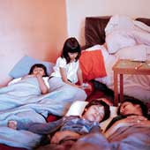
Overcrowding

Slide 218
If accommodation is too small for a household, you may be considered to be living in overcrowded conditions under the law.
A home may be legally overcrowded if there are not enough rooms or enough space for the number of people who live there.
Your house may become overcrowded if you have a new baby or if someone else (for example, a partner, parent or grandparent) comes to live with you.

Slide 219
Rooms
If two people of the opposite sex sleep in the same room, the accommodation will be overcrowded unless the two people are:
Married in a civil partnership or living together, or one or both of them are under ten years old.
The number of people of the same sex who can sleep in one room is restricted by the size of the room.

Slide 220
Space
The number of people who should live in a home depends on the number of rooms,
the size of the rooms
the ages of the people who live there.
Rooms that are counted include living rooms and bedrooms (but not the kitchen or bathroom).

Slide 221
For the room and space calculations:
Children under one year old are ignored;
Children over one and under ten year’s old count as half,
rooms under 50 square feet are ignored.

Slide 222
As a general rule:
1 room = 2 people can live there
2 rooms = 3 people can live there
3 rooms = 5 people can live there
4 rooms = 7.5 people can live there
5 rooms or more = 2 people per room can live there.

Slide 223
However, the size of a room also determines how many people can sleep there:
Floor area 50-69 square feet = 0.5 people can sleep there
Floor area 70-89 square feet = 1 person can sleep there
Floor area 90-109 square feet = 1.5 people can sleep there
Floor area 110 square feet = 2 people can sleep there.

Slide 224
When is overcrowding allowed?
Due to natural growth, such as a child reaching the age of eleven
Temporary, such as someone living in the home for a short period of time
Licensed overcrowding, where the council has given permission.

Slide 225
The space standard
The space standard is contravened when the number of persons sleeping in a dwelling is in excess of the permitted number,
having regard to the floor area of the rooms of the dwelling available as bedrooms.
For this purpose;
(a) A child under the age of five shall be reckoned as half a unit and,
a person aged five or over shall be reckoned as one unit, and
(b) A room is available as a bedroom if it is of a type normally used in the locality as a bedroom.

Slide 226
The permitted number of persons in relation to a dwelling is the aggregate for all such rooms in the dwelling of the numbers specified in column 2 of the Table set out below in relation to each room of the floor area specified in column 1;
But no account shall be taken for purposes of the space standard of a room having a floor area of Less than 50 square feet.

Slide 227
Floor area of Room 110 sq. ft. or more | Number of persons 2
90 sq. ft. or More but less Than 110 sq. ft. | 1.5
70 sq. ft. or More but less Than 90 sq. ft, | 1
50 sq ft or more But less Than 70 sq. ft. | 0.5

Slide 228
Detailed figures
Floor area (ft sq) | Floor area (msq) | People
50 to 70 | 4.64 to 6.5 | 0.5
70 to 90 | 6.5 to 8.37 | 1.0
90 to 110 | 8.37 to 10.2 | 1.5
110 above | 10.2 | 2.0

Slide 229
MANAGEMENT OF SOLID WASTE.
Objectives:
Define different terms used in solid waste management.
Explain different types of solid waste and their management.
Identify different types of Health care waste, its dangers and how it can be disposed off.
Describe the mechanism of municipal waste management in a sanitary landfill.

Slide 230
Introduction:
Waste: is any substance or anything that the user no longer needs
Waste can be divided into two main types according to consistency.
Solid waste and liquid waste.
Solid waste: is waste material that contains less than 3% water
for example house hold garbage,
some industrial waste etc;

Slide 231
Introduction:
Liquid waste: is usually waste waters that contain less than 1% solid.
Sludge: is a class of waste between liquid and solid.
It usually contains between 3% and 25% solids.
Solid waste is further subdivided into different types depending on the source examples;
House hold waste,
Municipal waste
Industrial wastes which are hazardous.
Biomedical waste or health care wastes are described as infectious waste.

Slide 232
Municipal solid waste:
Consists of house hold waste, construction and demolition debris, and waste from street generated mainly from residential and commercial complexes.
With rising urbanisation and change in life style, and food habits,
the amount of municipal solid waste has been increasing rapidly and its composition changing.

Slide 233
waste and time for degradation
Type of solid waste | Time taken for waste to degradation.
Organic waste e.g. vegetable and fruit peels, food staffs etc. | A week or two
Paper | 10-30 days
Cotton cloth | 2-5 months
Wood | 10-15 years.
Woollen items. | 1 year
Tins, Aluminium and cans | 100-500 years
Plastic bags | I million years
Glass bottles | Undetermined

Slide 234
Hazardous waste
This is the type of waste that is highly toxic to humans, animals, and plants.
It may be corrosive,
highly inflammable, or
explosive and react when exposed to certain things like gases.
In the industrial sector, the major generators of hazardous waste are the metal, chemical, paper, dye, refining and rubber industries.

Slide 235
Hazardous waste………………
House hold wastes that can be hazardous include:
old batteries,
shoe polish,
paint tins, and old medicines.

Slide 236
Medical health care waste.
Up to 25% of health care waste is hazardous and may create a variety of ill health challenges.
About 75% of the general health care waste is non risky
Classification of hazardous health care waste;
It includes Infectious waste,
pathological,
sharps,
pharmaceutical,
genotoxic,
chemical, waste with high content of heavy metals,
radioactive waste.

Slide 237
Medical health care waste…...
Pathological waste.
Consists of tissues,
organs,
body parts,
human foetuses and
animal carcases,
blood and body fluids,
Human body parts are also known as anatomical waste.
This category may also be considered as highly infectious waste.

Slide 238
Sharps
Sharps are items that could cause cuts or puncture wounds.
These Include:
needles,
blades,
knives,
infusion sets etc.
Whether contaminated or not, such items are considered as highly hazardous health care waste.

Slide 239
Pharmaceutical waste
It includes:
expired drugs,
unused spilled and contaminated pharmaceutical products,
drugs, and vaccines that are no longer required.
These also include discarded items like bottles,
gloves used in handling,
masks and boxes with residues.
All these type of waste are referred to as toxic waste

Slide 240
Genotoxic waste:
Genotoxic waste is highly hazardous.
It may have mutagenic teratogenic or carcinogenic properties.
These include:
cytotoxic drugs,
vomitus,
urine, or faeces from patients treated with cytotoxic drugs.
There are also chemicals and radioactive material.

Slide 241
Chemical waste;
These consists of discarded solid, liquid, and gaseous chemicals.
Chemicals are considered hazardous if they have the following properties: -
corrosive, e.g. acids and bases,
flammable,
reactive e.g. explosive, genotoxic e.g. cytotoxic drugs.

Slide 242
Chemical waste;………….
Examples include:
formaldehyde,
photographic chemicals,
solvents e.g. chloroform,
organic substances e.g. insecticides,
inorganic substances e.g. acids etc.

Slide 243
Radioactive waste
Ionising radiations cannot be detected by any of the senses, other than the burns which occur in exposed areas,
usually there are no immediate effects unless an individual receives a very high dose.
The ionising radiations of interest in medicine include X-rays.

Slide 244
Persons at risk
All individuals exposed to hazardous health care waste are at risk.
Including those within hospital and those outside
Everyone who either handle such waste or are exposed to it as consequence of careless management.
These include, nurses, doctors, healthcare auxiliaries, and hospital maintenance personnel

Slide 245
International recommendations for waste management.
The United Nations conference on the environment and development (UNCED) in 1992 emphasised
prevention and minimisation of waste production,
re- use or recycling of waste where possible
treatment of waste by safe and environmentally sound methods.

Slide 246
International recommendations for waste management.
Dispose off the final residues by land fill in confined and finally designated sites.
It also stresses that any waste producer is responsible for the treatment and final disposal of the final waste
and that a community should dispose off its waste within its own boundaries

Slide 247
Note:
Genotoxic: substance that is toxic to the genes
Mutagenic: substance that causes genetic mutation
Teratogenic: An agent or factor that causes embryo malformation.
Cytotoxic: toxic to living cells.

Slide 248
Handling, storage and transportation of health care waste.
Waste segregation and packing is key to effective mgt of H/c waste.
Segregation (separation) and identification of the waste, appropriate handling, treatment and disposal of the waste by type reduces the costs and does much to protect Public Health
Segregation should always be the responsibility of the producer and should take place as close as possible to where the waste is generated.
It should be maintained in storage areas and during transportation.

Slide 249
Handling, storage and transportation of health care waste.
The most important way of identifying the categories of health care waste is by sorting the waste into colour coded containers
General health care waste should join the stream of domestic refuse for disposal.
Sharps should be collected together regardless of whether contaminated or not.
The containers should be puncture-proof (usually made of metal or highly density plastic) and fitted with covers.
They should be leak proof and impermeable to retain sharps and residual liquids from syringes.

Slide 250
Containers should be tamper proof (difficult to open to avoid abuse.
Large quantities of absolute drugs should be returned to the pharmacy for disposal.
Large quantities of chemical waste should be packed in chemical resistant containers and sent to specialised treatment centres.
Hazardous chemicals identified should be marked on the container and shouldn’t be mixed with other chemical wastes.
Bags and containers for infectious waste should be marked with international symbol.
Wastes with high content of heavy metals e.g. cadmium, mercury and lead should be collected separately.
Incineration should be the disposal method of choice for most hazardous health care wastes.

Slide 251
Recommended color coding for H/C waste;
Type. | Colour of container. | Type of container.
Infectious Waste, Used iv sets, dressings, gauze, gloves | Yellow Bin | leak proof container or plastic bag
Highly infectious waste. | Red container | Strong leak proof container or plastic bag.
Anatomical waste, pathological | Red container | Leak proof plastic bag/ container.
Sharps | Yellow marked sharps. | Puncture proof.
Chemical and pharmaceutical waste. | Brown. | Plastic bags or containers.
General health care waste. | Black | Plastic bag.

Slide 252
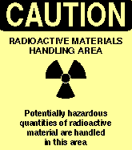


International symbols
Radiations Biohazard

Slide 253
Factors to consider for Rx and disposal technologies of H/C waste (Biomedical)
Operation and maintenance of the method
Infrastructure requirement
Volume and mass reduction after treatment
Occupational health and safety considerations
Training requirements for operation of the method
Available space
Public acceptability
Location and surrounding of the treatment site

Slide 254
H /C waste disposal
Use of single chamber incineration,
Drum
brick incineration,
Chemical disinfections,
Wet thermal treatment,
Micro wave irradiation,
Encapsulation,
Safe burial on hospital premises,
Sanitary landfill,
Discharge to sewer.

Slide 255
Cytotoxic waste.
Cytotoxic waste is highly hazardous,
it should never be discharged into sewerage or be land filled.
Expired cytotoxic drugs should be returned to original supplier.
Pack them properly and label them expired drugs, not for sale.
Cytotoxic drugs are only destroyed at very high incineration temperatures of 1200ºC.

Slide 256
Cytotoxic waste………...
Small incinerators at temperatures 400- 1000⁰C will lead to release of hazardous vapours into the atmosphere.
Use modern double chamber incinerators with high temperatures of >1200⁰C.
Examples of cytotoxic wastes that should be destroyed at 1200ºc
Carmustine at 1000⁰c, Cyclophosmide at 900⁰C, Dactinomycine at 1000⁰C
Danunorbicine at 1000⁰, Etoposide at 1000⁰c, Mitomycine at 1000⁰c
Vincristine at 1000⁰c

Slide 257
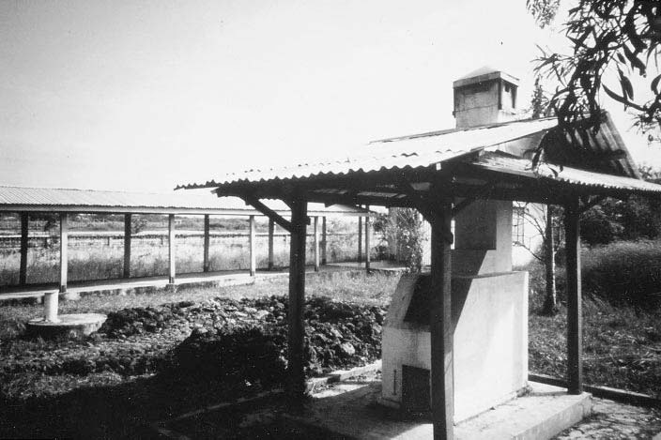
Single chamber incinerator.

Slide 258
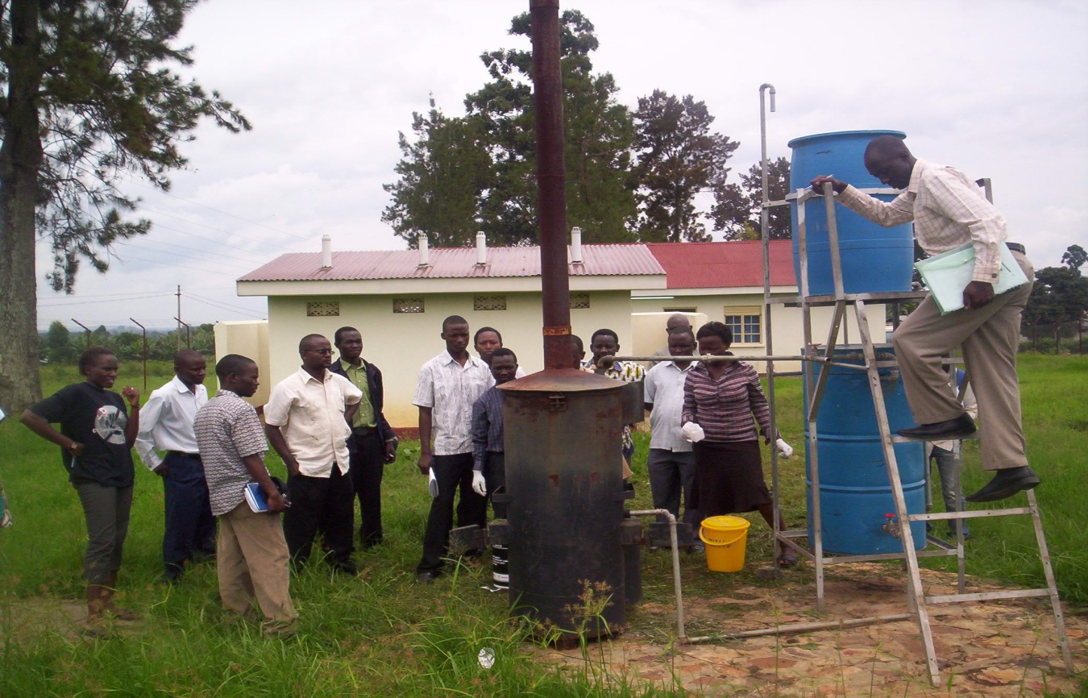
Incineration of Health Care waste in a rural Health centre in Uganda

Slide 259
Advantages of incineration
It is adequate for all infectious wastes,
It has appropriate disinfection efficiency, there is drastic reduction of weight and volume of the original waste being incinerated,
the final residual (ash) contain less than 3% of un-burnt matter and it may be disposed off in landfills.
Running of incinerator does not need highly trained operators.
Has low investment and operating costs make an incinerator
the most ideal for Health care waste management.

Slide 260
Disadvantage
There is emission of significant atmospheric pollutants
need for periodic removal of soot.
It is in-efficient in destroying thermally resistant chemical and drugs like cytotoxics.
It doesn’t incinerate pressurised containers,
Halogenated plastics like PVC and wastes with high content of metals are not incenerated .

Slide 261
Chemical disinfection
Chemicals ensure highly efficient disinfection under good operating conditions.
Some chemicals are however expensive to afford.
Chemicals disinfectants are basically suitable for liquid wastes like blood socked linen, stools, urine, and hospital sewage contaminations.
The most frequently used chemicals for disinfection include Jik and savlon.

Slide 262
Wet thermal treatment
Infectious waste is exposed to high pressure steam similar to autoclave stem sterilizer.
High temperature due to steam inactivates the micro organism

Slide 263
Inertization (encapsulation)
involves mixing waste with cement, water or lime before disposal in order to minimize the risk of toxic substances contained in waste migrating into surface or ground water.
It is suitable for pharmaceuticals and incineration ashes that contain high metal content.
The process uses either cubic boxes made of high density polyethylene or metallic
The containers or boxes are then filled with a medium such as plastic foam, bituminous sand, and cement mortar or clay material.

Slide 264
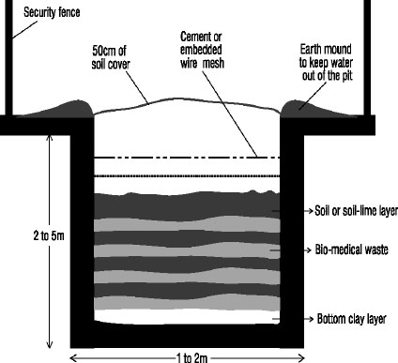
Burial pit for Health care waste.

Slide 265
Waste pit
A waste pit is dug to burry health care waste in small health facilities which have no incinerators.
The pit is filled with Health care waste alternating with a 10 cm layer of soil covered every day.
The pit is secured with a fence to avoid children or animals accessing and removing the waste.
The above figure indicates a standard burial pit recommended by WHO for health centres.

Slide 266
Workers at risk of Health care waste.
Everyone in a hospital setting is at risk of health care waste.
This includes; health care providers, hospital cleaners, maintenance workers, operators of waste treatment equipment.
Workers protection
Protective gears like industrial aprons, overalls and heavy duty gloves are obligatory for all exposed workers.
There is also a need to provide hand washing facilities. The need to waste immunise with hepatitis & T.T vaccination to those in waste management.

